Slide 1
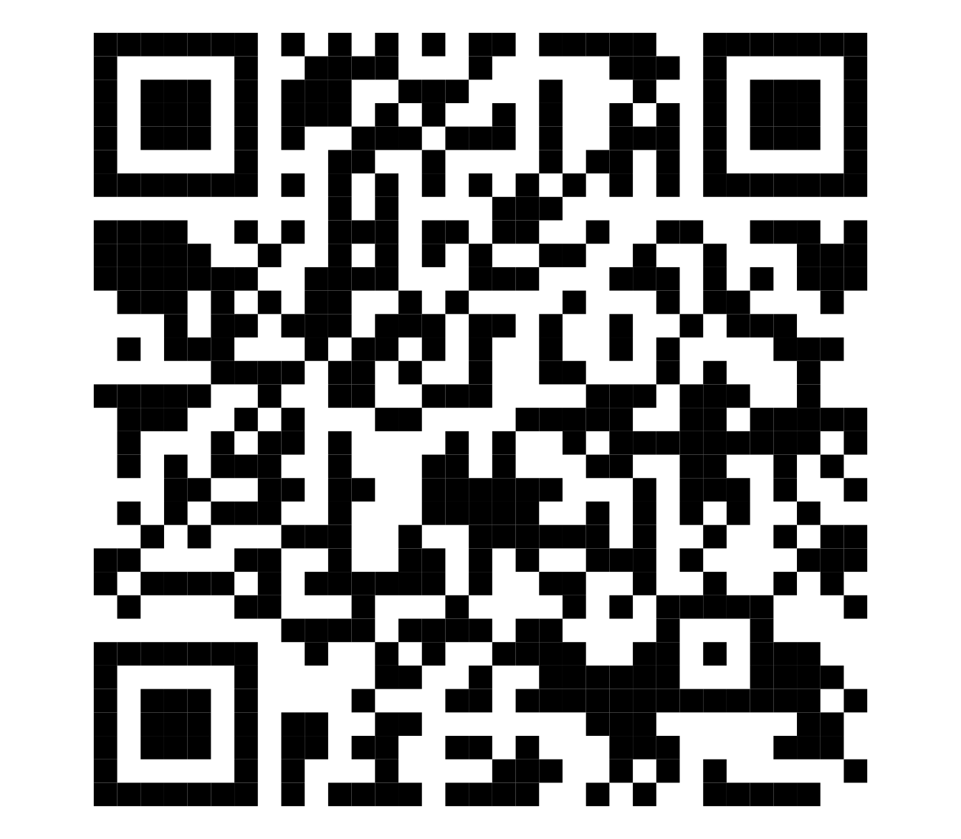
Unionization, AI, and You
Brian Meeker
https://github.com/CuriousCurmudgeon/unionization_ai_and_you_talk
Notes:
Before we get started, if anybody wants to grab the slides right away, that QR code will take you to the GitHub repo for this talk.
Good morning everybody and welcome to CodeMash. I hope your first session of the day went well.
Before we get started, I want to remind you of the rule of two feet. If the content of this talk just isn't working for you, vote with your feet and go make better use of your time. I won't be offended.
That being said, this is my 12th CodeMash and I have never seen a talk at this conference like the one I'm about to give. Most career development talks focus on the individual or leadership of a team. Today, we're going to talk about the collective. Let's get started.

Slide 2
"Horizontal Team Building"
Notes:
And if your boss asks you what sessions you went to, I recommend referring to this one as "Horizontal Team Building". Substitute whatever euphemism you prefer.

Slide 3
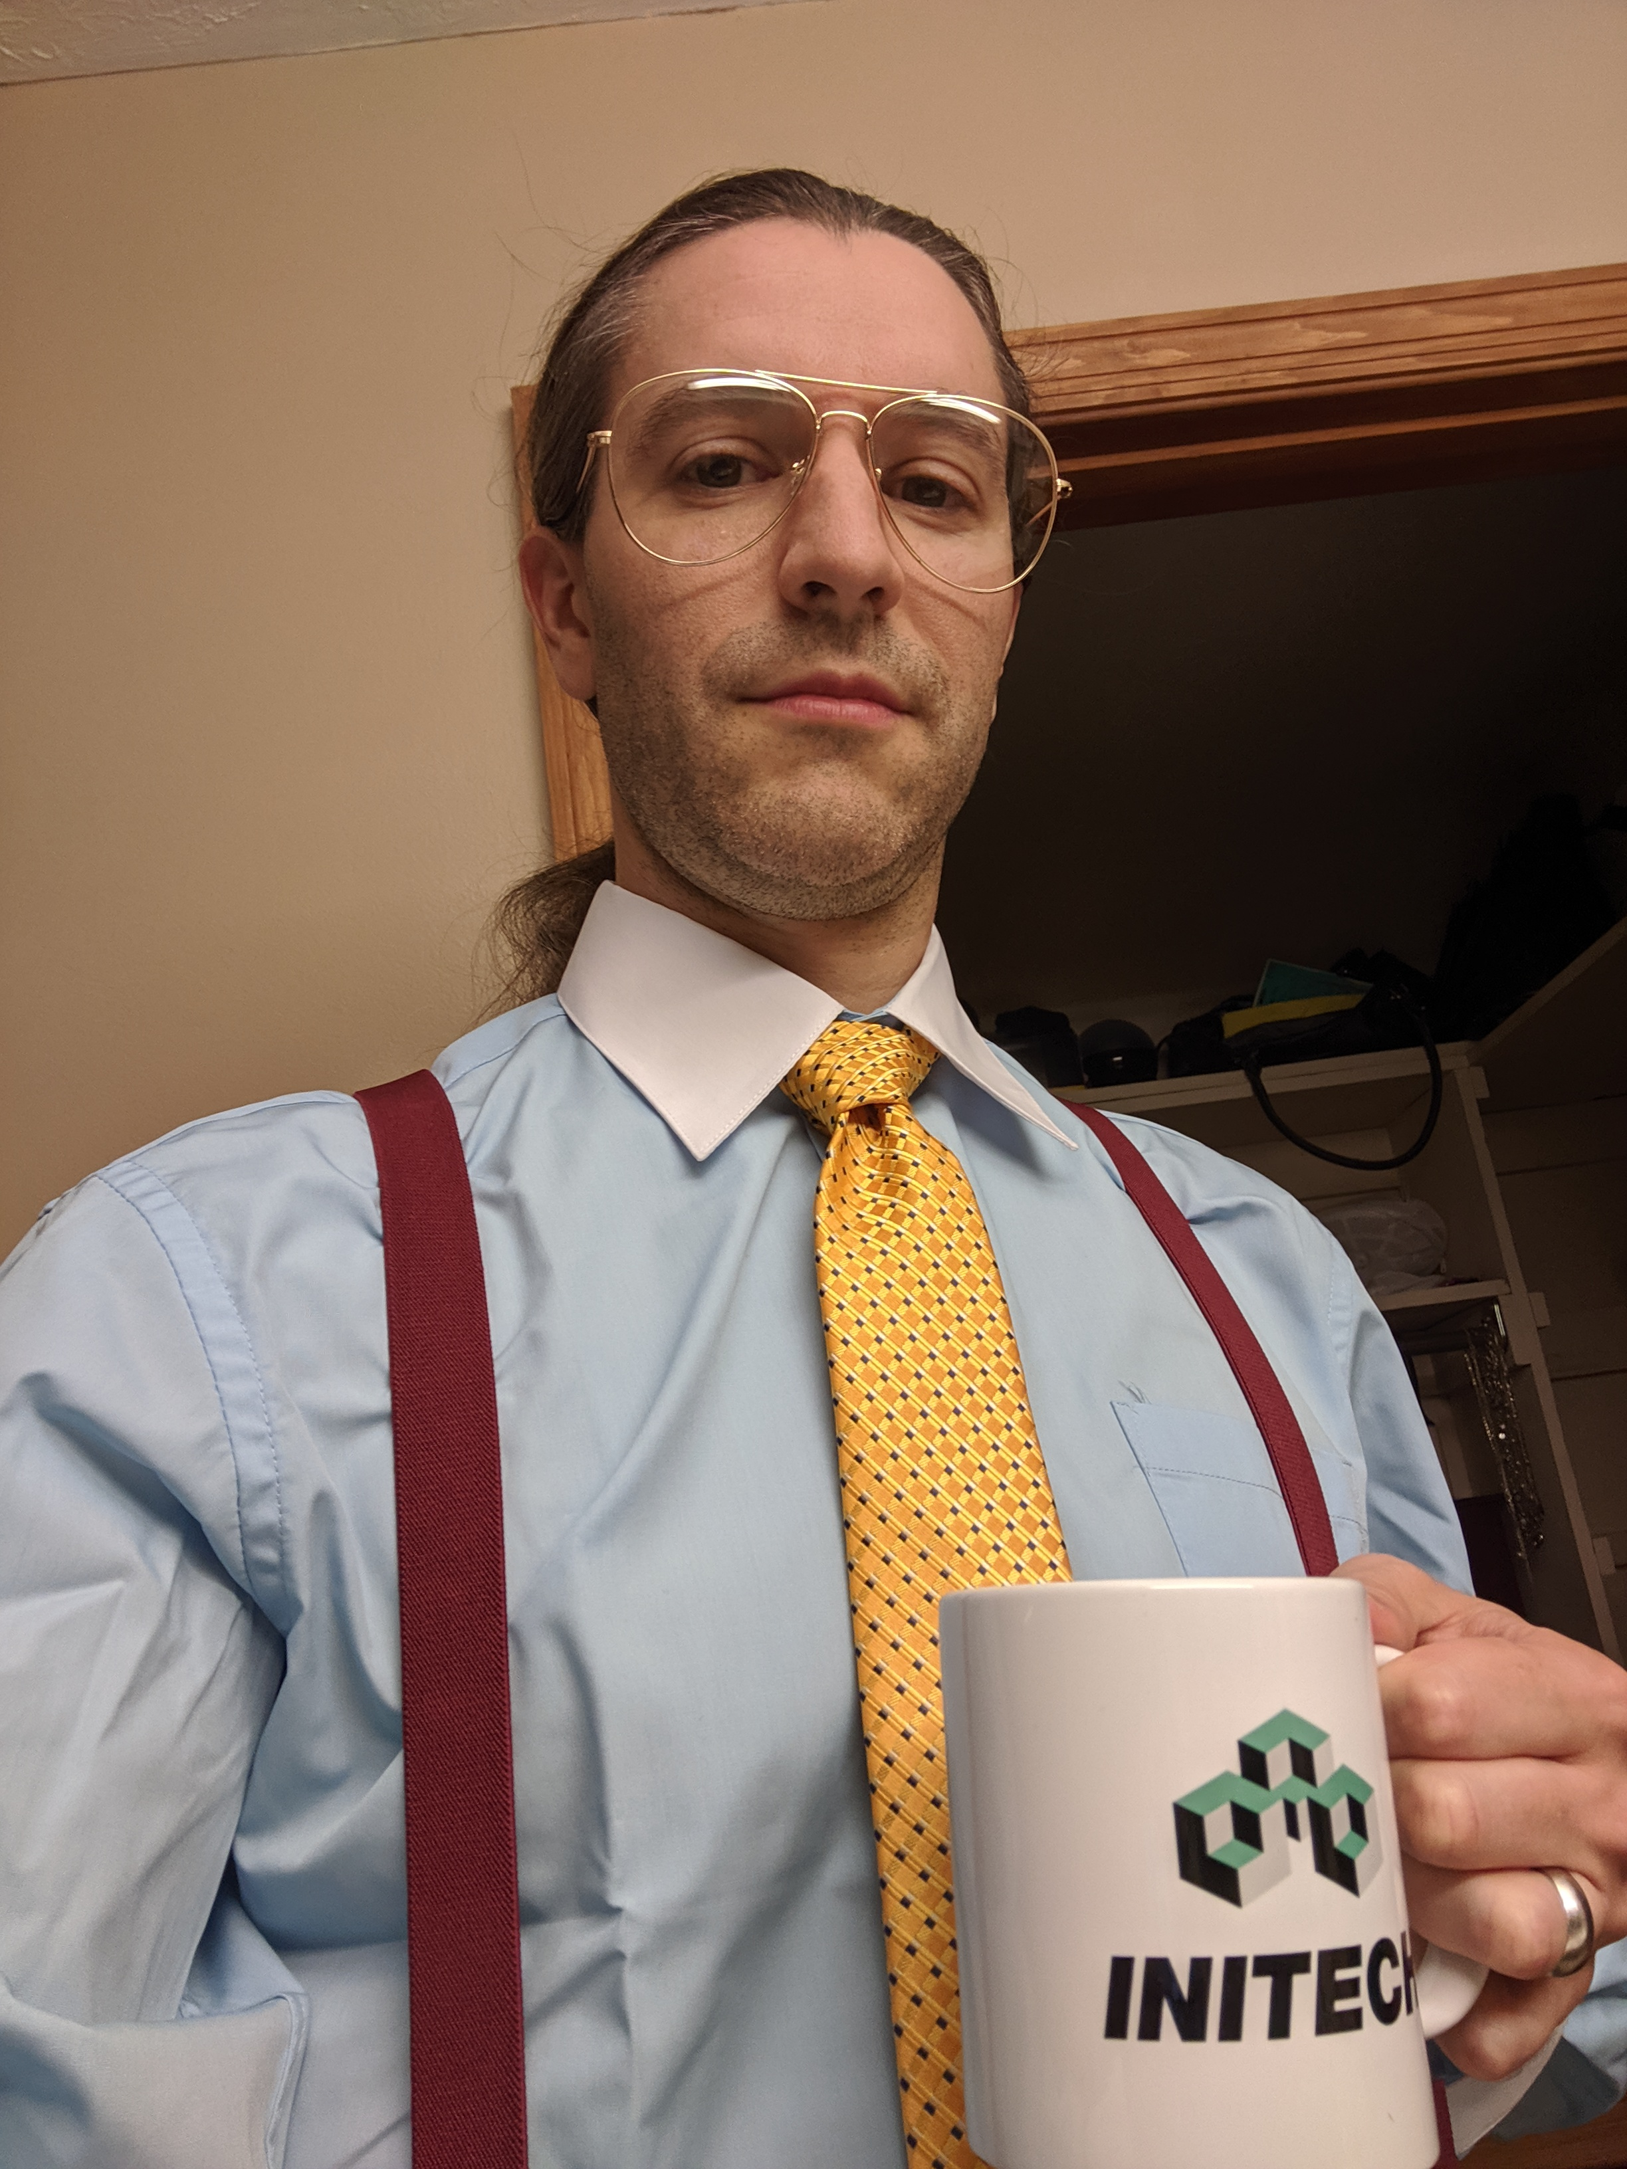
Brian Meeker
Blog: https://brianmeeker.me
GitHub: @CuriousCurmudgeon
Bluesky: @brianmeeker.bsky.social
Notes:
My name is Brian Meeker. I've traveled here today from the far off lands of... Indiana.
I spend my work hours as the engineering manager at GetThru. That change was very recent, which is somewhat relevant for this talk. Fortunately, I still get to write code. For now.
You can mostly find me these days on Bluesky.
Public speaking is usually great for resume building. I fully expect this talk to be the opposite. Some companies will never associate with me for giving a talk like this. I'm fine with that.

Slide 4
Unionization
Notes:
This talk is about unionization. Unionization is inseparable from politics in America. I'm not going to dwell on politics during this talk, but it will come up from time to time out of necessity.

Slide 5
AI
Notes:
The impetus for this talk is AI. We're all tired of talking about AI, so we're not going to talk about directly in this talk. But it is hovering in the background of all of this. Our industry is at the cusp of the largest upheaval in decades, possibly ever. Many of you work for companies that see your work as a cost center. They prefer to view developers as a fungible asset. They would love to pay you less. They would love to cut your perks. They would love to cut your benefits. These are all numbers in a spreadsheet with one goal: line goes up.
AI is an opportunity for them to do just that. If you think your CEO is ultimately on your side, you're almost certainly wrong. Non-technical CEOs at tech companies have been beholden to what engineering says can and can't be done for decades. They will gladly jettison you for an AI tool that doesn't question them, costs much less, and compliments them along the way. Stockholders and investors will rejoice.

Slide 6
You
Notes:
And that's why this talk is about you. It's about the power you have to exercise control over your fate and the fate of your co-workers. The best time to exercise that power was five years ago. The second best time to exercise that power is now.

Slide 7
What scenario could be better for workers to learn which side politicians are on than when delegations of workers themselves seek their active support in trying to reach an agreement against large, intransigent multinational corporations making record profits?
Rules To Win By by Jane McAlevey and Abby Lawlor 6
Notes:
The majority of this talk will be nuts and bolts of labor organizing in the worker-to-worker model. We'll go through the process from beginning to end with tangents as necessary. Fundamentally, this model is about bringing democracy to the workplace. As the political moment has shown us, not as many people care about democracy as we had assumed. The worker-to-worker model fights this by giving you direct power. People care about democracy a lot more when they feel listened to. When they feel like their voice matters.

Slide 8
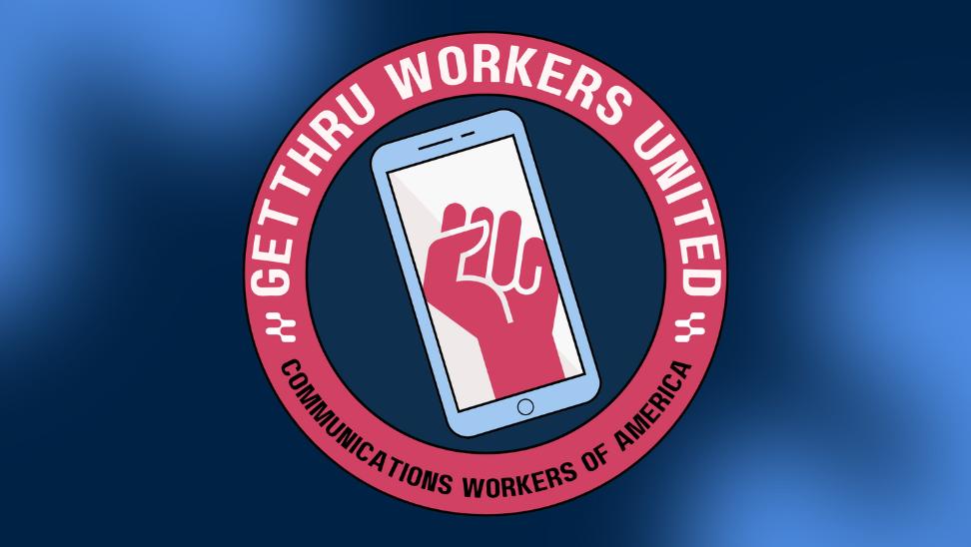
Notes:
When I submitted this talk, I was a member of GetThru Workers United. I'm now engineering manager, so have been moved out of the bargaining unit. I'm still here to talk to you about unionization in the tech industry though.
Our bargaining unit is currently 13 members I think. After contract ratification, I served as shop steward until being moved into management. This means that I represented and defended the interests of fellow employees in the bargaining unit.
GetThru was formed in 2016 out of the ashes of the Bernie Sanders presidential campaign. Our founder ran his text messaging campaign. We are a SaaS company provide phone banking and text messaging services to universities, non-profits, unions, and progressive political campaigns.

Slide 9
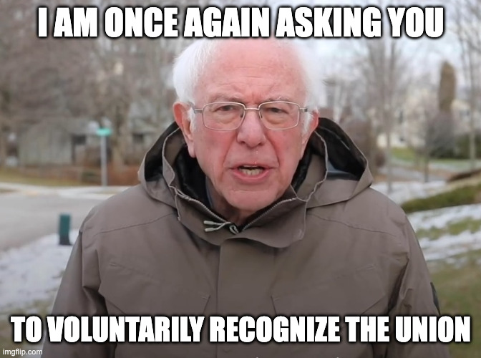
Notes:
After a round of layoffs in 2022, the remaining employees voted to unionize. The odd part of our journey is that GetThru voluntarily recognized the union. This means that we showed that over 50% of employees had signed union cards and GetThru accepted that.
This is highly unusual. Most companies fight back (we'll get back to that) and force an election through the NLRB, the National Labor Relations Board. This is a very bureaucratic and adversarial process. We're lucky that we didn't have to go through that.
At the same time though, the company was backed into a corner. It's a really bad look for a company spun out of the Bernie Sanders campaign to union bust. Really bad.
Now, that didn't mean that contract negotiations were smooth sailing. It took almost three years to go from voluntary recognition to a ratified contract. There was another round of layoffs in there after the 2024 election. But it was nice that they didn't bring in a union busting law firm. You will probably not be so lucky.

Slide 10
If your labor contributes to a digital product or service and you are compensated for that labor, then you perform tech work. You are a tech worker.
You Deserve a Tech Union by Ethan Marcotte (7)
Notes:
In recent years, tech workers have woken up to their power.

Slide 11

Notes:
On February 18, 2020, Kickstarter employees voted to form a union, Kickstarter United. They ratified their first contract on June 17, 2022. This is all documented well in the Kickstarter United Oral History podcast. Glitch started their unionization process after Kickstarter, but signed their first contract first in February 2021

Slide 12
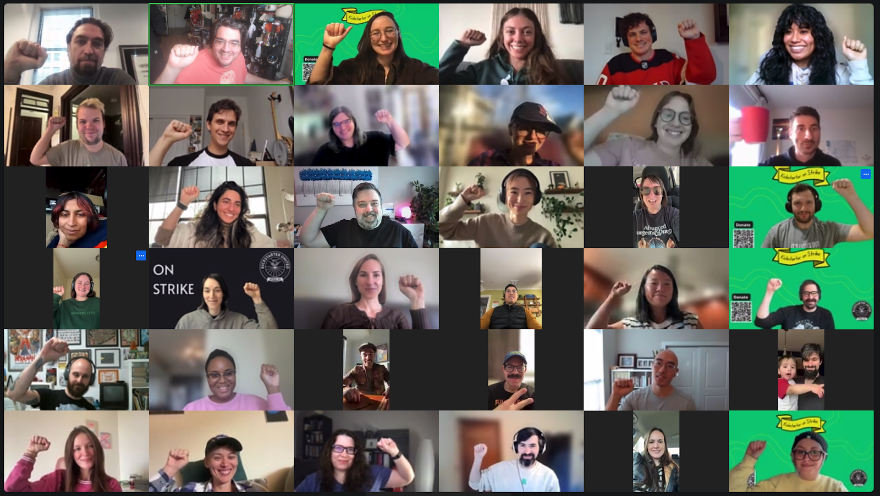
https://www.rascal.news/kickstarter-united-ends-six-week-strike-with-a-resounding-victory/
Notes:
Kickstarter United recently won a second contract after a 42 day strike. They protected their collectively bargained 4 day work week, established a minimum salary, and protections against AI taking their job.

Slide 13
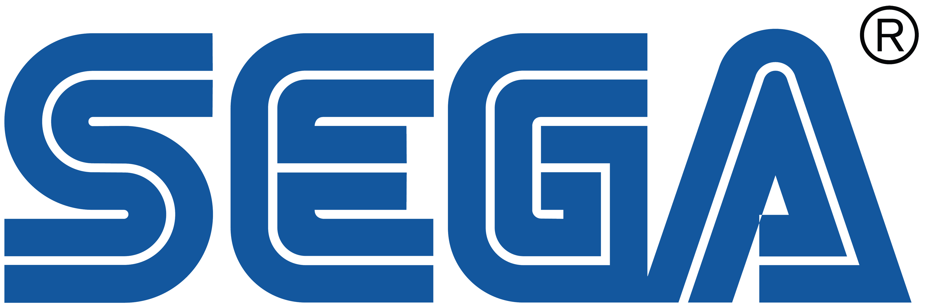

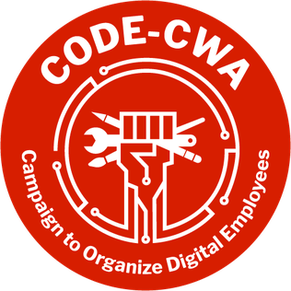
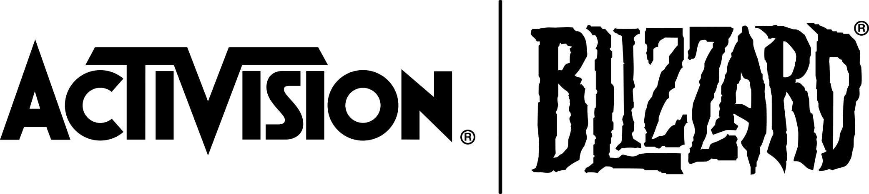
Notes:
Over 6,000 workers across the video game and tech industries have unionized with CODE-CWA (Campaign to Organize Digital Employees) since 2020. This includes employees at major studios like Sega of America, Activision Blizzard, and Bethesda.
Most of these efforts started in QA, but World of Warcraft is now wall-to-wall. They were recognized by Microsoft in July 2024. The union includes designers, engineers, producers, artists, quality assurance testers, and other game developers.
Combined with years of exploitation, underscoring all of this has been a brutal series of layoffs across the entire gaming industry. We've seen similar layoffs across big tech companies in that period as well, so why aren't we flexing our power as well?

Slide 14
Unions are conduits for worker demands and fairness in the workplace.
A Collective Bargain by Jane McAlevey
Notes:
What is a union? A union is what you want it to be.

Slide 15
What is a union?
A collective effort by all employees who work for an employer
To stop the boss from doing what you don't want him to do. Discharge, unfair layoff, promotion, speed up, etc.
To make the boss do what you want him to do. More pay, vacation, holidays, health coverage, pensions, etc.
And, to be used in any other way the members see fit.
Bernie Minter - District 1199 organizer (typed notes)
Notes:
It is a collective effort by employees to improve your working conditions in whatever way you define it to be. It is your union. You do with it what you will.

Slide 16
People are flawed, and unions are made up of people, so unions, too, can be flawed.
McAlevey, A Collective Bargain 16
Notes:
Every organization ever formed by people is flawed by the nature of humanity itself. Doesn't matter if it's a friendship, a marriage, your local city council, a church group, a national political party, or a union. They're all flawed. But that does not mean that most of those things are not worth pursuing.
Many of the folks in this room may have personal family experience with unions. We are after all in the rust belt. You may have grown up seeing an ineffectual UAW prove impotent as auto plants closed.
I watched my dad's seniority be used as a bargaining chip in contract negotiations. Just like that, ten years of seniority he was promised when accepting a deal from Packard Electric to work for GM again was gone.
I know first hand how unions can fail. I saw how they become yet another layer of bureaucracy. I don't stand before today naive to flaws of unions as a human organization
We currently live in an era of plummeting trust in institutions. Legacy institutions are almost universally distrusted and assumed to be corrupt. Many of us feel like those institutions are only there to preserve their own existence. Any mission they may have once had to a broader society was jettisoned long ago.

Slide 17
Don’t be afraid to ask workers to build their own union
SEIU Local 1199 Advice For Rookie Organizers
Notes:
But your union does not have to be this way. Participatory unions give power to their members. They empower them to mold their own working conditions through a democracy that is small enough and direct enough to feel like it actually matters. It feels a lot different to participate in a bargaining unit of 13 members than a democracy of 300+ million. It's a lot easier to feel trust when you personally know every single person in the room.
If you had told me two years ago that I would be standing at a tech conference giving a talk like this, I would have thought you insane. Yet here I am. I recognize that unions are not a universal good. But your union is still worth fighting for.

Slide 18
Unions are democracy at work
Notes:
Unions are democracy in the workplace. If you told me a decade ago that most Americans don't prioritize democracy, I would have scoffed. Today, it seems more obviously true. They may care, but the benefits feel far more distant than economic pressure. Less real than whatever social media is telling them to be scared about this week.
But if you believe that democracy has no place in capitalism, then you're arguing against democracy in any meaningful way. Capitalism is on an unending path towards swallowing more and more of the public sphere. Prediction market CEOs explicitly talk about wanting to financialize everything. But if everything is financialized and the only thing left to vote with is our dollars, then democracy has failed. It is limited to a smaller and smaller sphere of life.
I propose to you that if you believe in both capitalism and democracy, democracy in the sense where people's vote actually matters and produces tangible change in their lives, then unions are possibly the purest expression of that. If corporations dictate more and more of our day-to-day lives, then there must be a meaningful lever of democracy that we can pull to make our voices still matter.

Slide 19
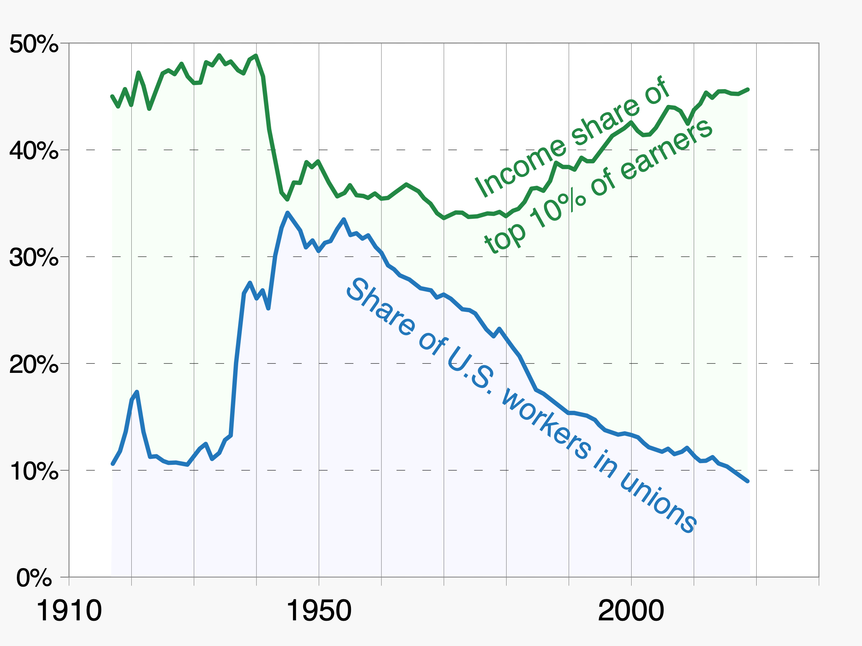
https://www.nytimes.com/2023/07/07/briefing/unions-living-wage-working-documentary.html
Notes:
Maybe you don't care about democracy. Maybe you care more about income inequality. Unions can help. And yes, you could overlay many, many correlations on this chart that look very similar. But given that unions can explicitly bargain for increased wages, that feels stronger than just a correlation.

Slide 20
You know, like the idea that like by us organizing we're taking a union out of a hungry coal miners mouth or something, you know, it's like you know you're not a scarce resource like we're… like everyone should have one, we're not… like yeah let's organize it and we are in fact maybe encouraging other people to get a union. It's not a zero sum game there.
Patrick - Former Senior Software Engineer at Kickstarter
Redwine, Clarissa, host. "Chapter 5: Captive Audience | Part 1", Kickstarter United Oral History, 3 Nov. 2020 https://eclive.engelberg.center/episodes/chapter-5-captive-audience-part-1
Notes:
But you might be thinking that we have it so good in tech. We don't need unions. Those are for the less fortunate! No, you starting a union does not hurt the less fortunate in any way. Unions are not a scarce resource. You're not taking anybody's union away by starting your own. In fact, you can help them by standing in solidarity when they are on strike against their employer. This is not a zero sum game.

Slide 21
What happens when your management mandates a change in your workplace, a change that makes you feel unsafe? In other words: how temporary are the benefits you enjoy at work? How quickly can they change?
Marcotte 69
Notes:
Many of us in tech have had a great deal for many years. That deal is not guaranteed to continue though. The best time to unionize may have been five years ago. The second best time is now. We should flex our power while we still have it.

Slide 22
Webster defines [planning] as "making plans ... arranging beforehand." I like this simple definition because it says that there are planners as well as plannees; there are those who plan and those who conform to what was arranged beforehand. Just as it is easier to give good advice than it is to accept it, it is much more fun to plan than it is to be subjected to plans made by others.
The Real World of Technology by Ursula Franklin (78)
Notes:
We all have felt what it feels like when you are the plannee. When you're at the whims of others. You must conform to their plans, no matter how nonsensical they are.
Unions give you power to be the planner. They give you a seat at the table of power so that you are not subjected to plans made by others.
Let me give you an example, at GetThru we have 100% employer paid health insurance for us and our families. I pay absolutely nothing for my wife and kids to have insurance. And I am very, very confident that this would have been taken away by now if it was not negotiated in our contract. We are not at the whims of our employer. We have a seat at the table. We get to be the planners too.

Slide 23
IANAL
Notes:
Who can tell me what this acronym means? Just shout it out.
Before we start getting into the weeds here, I want to be very, very clear. I am not a lawyer. I am not your lawyer. As you get into this process, one reason to partner with a parent union is because they do have lawyers to keep you on a good path. So, once again, I am not a lawyer. This is not legal advice.
With that out of the way, we're going to be primarily talking about collectively bargained unions today. That is what most people think of when thinking about unions. I want to mention pre-majority unions though..

Slide 24
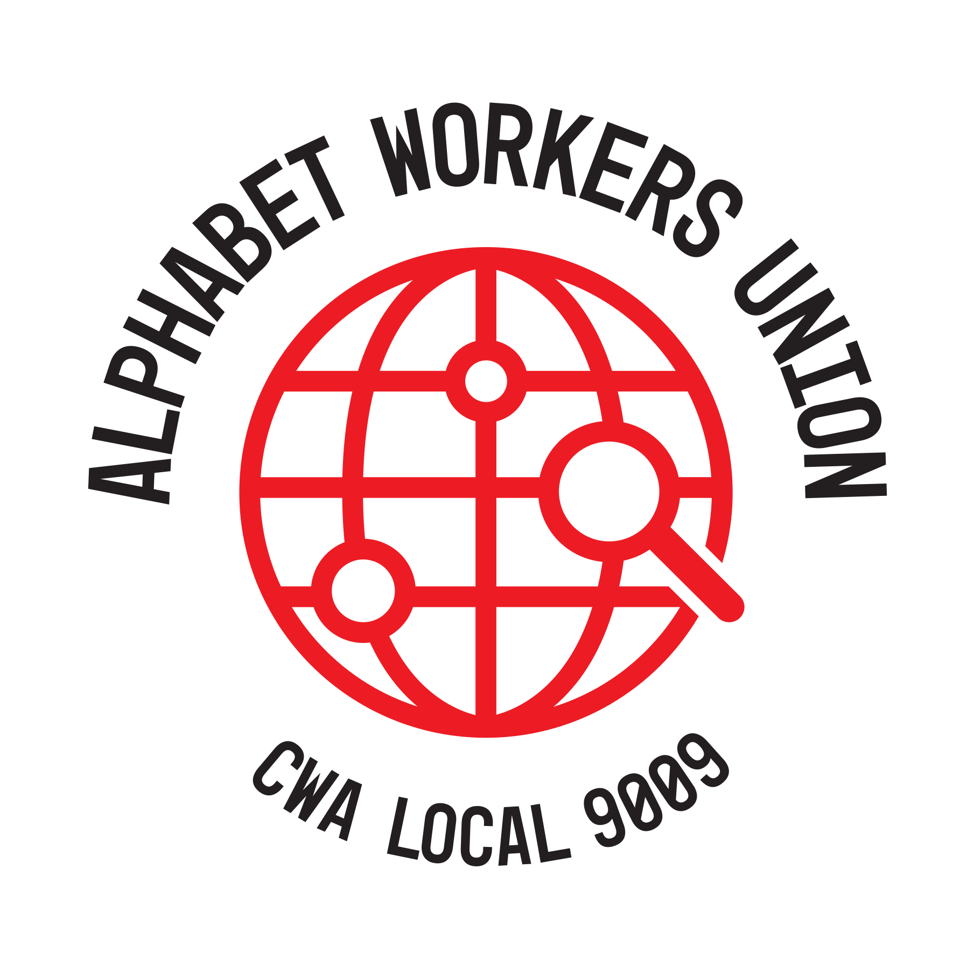
Notes:
the most well known of which is Alphabet Workers Union.
The big advantage of pre-majority unionism is that your employer has no say in the matter. It aspires to be a traditional union in all ways except the company doesn't have to collectively bargain with it. That is obviously a pretty big caveat.
Why would you want this model then?
The first reason is in the name, pre-majority. You may work at a company that has no hope of unionizing. Not enough co-workers are interested. Or you're slowly building support, but want to do so more publicly.
Or maybe you work in the public sector in a conservative state that does not allow public sector employees to unionize. Pre-majority unionism might make sense for you.
The other big reason for tech is subcontractors and "gig" work. Sub-contractors and gig workers cannot unionize under current law. But they can be part of a pre-majority union. Alphabet Workers United takes advantage of this to advocate for the sprawling network of contractors that Alphabet relies on for things like content moderation on YouTube.

Slide 25
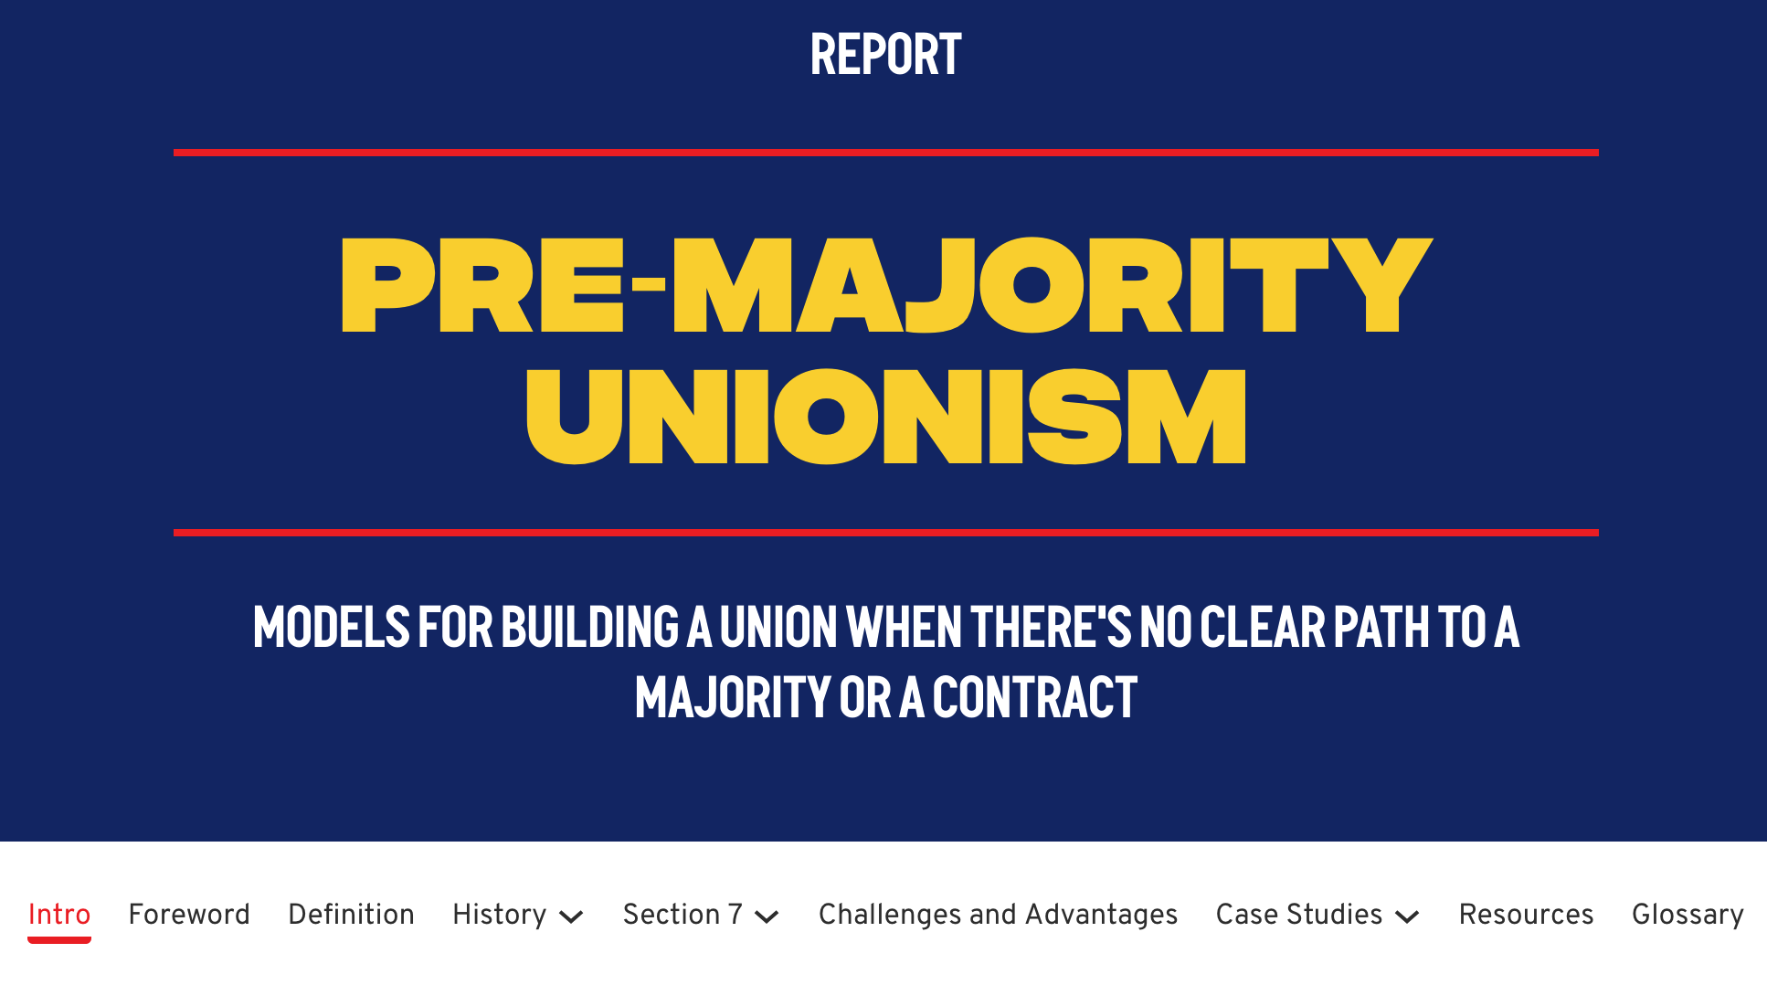
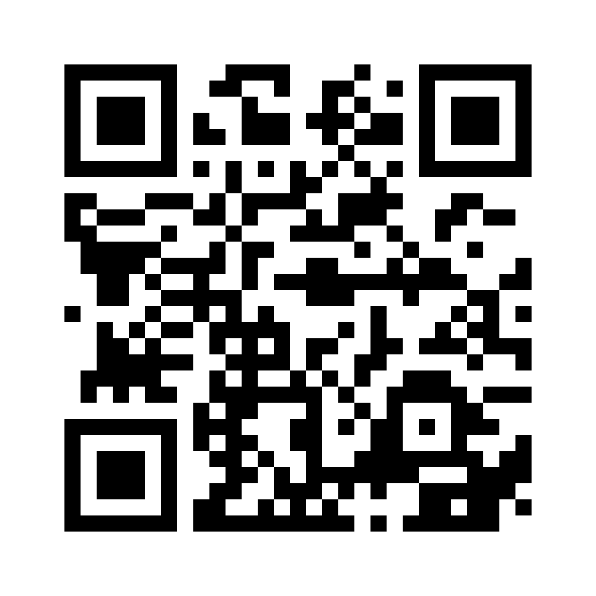
https://workerorganizing.org/premajority-unionism/
Notes:
Pre-majority unionism is a deep topic that I'm not well versed on in practice. I encourage you to check out the Pre-Majority Unionism guide from the Emergency Workplace Organizing Committee to learn more.

Slide 26
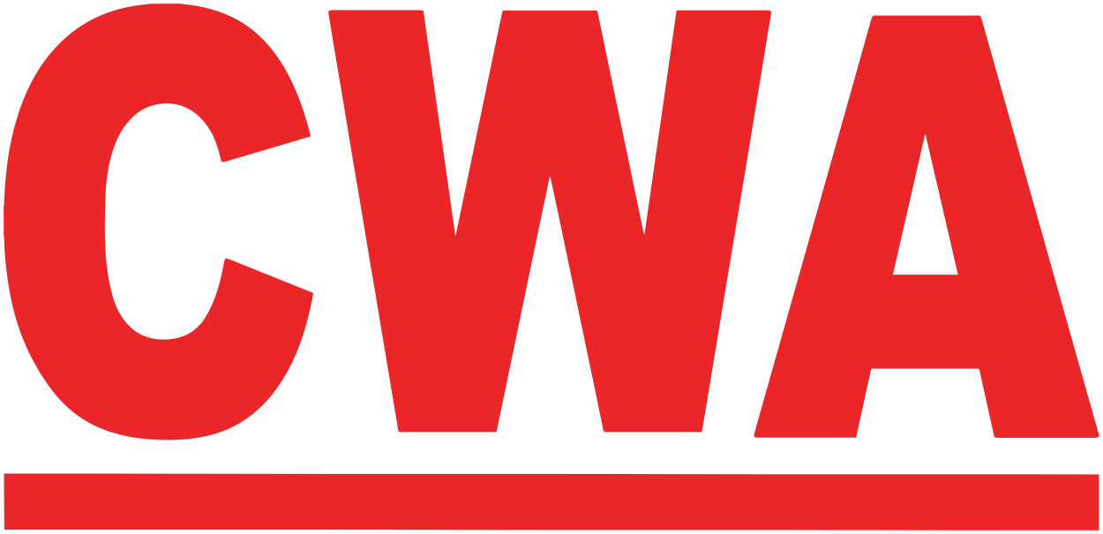
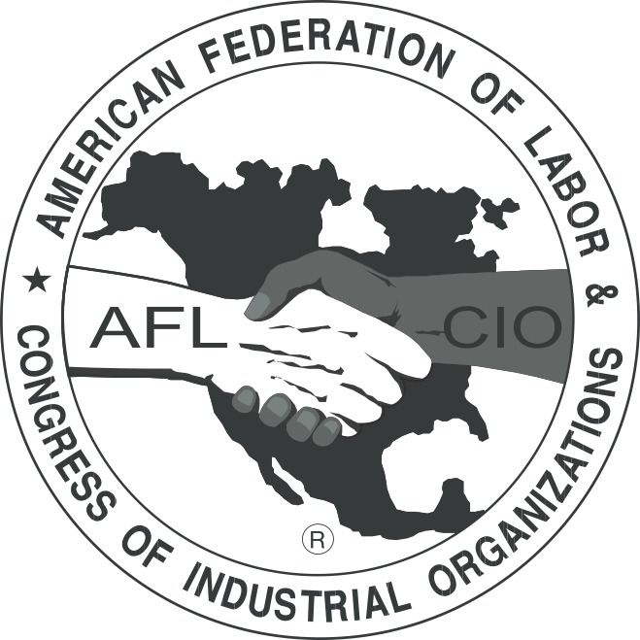
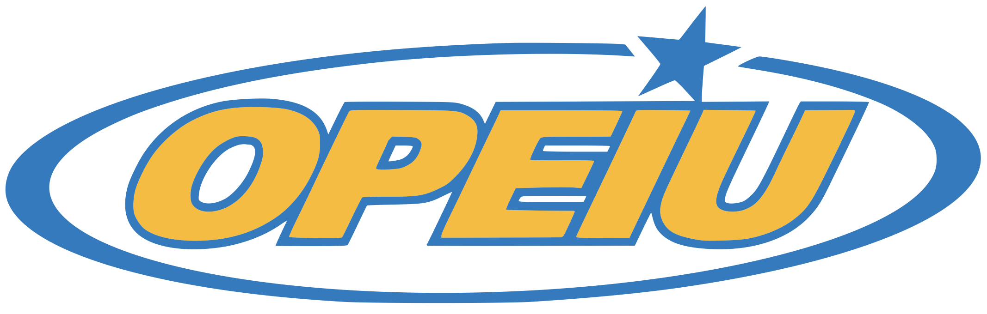
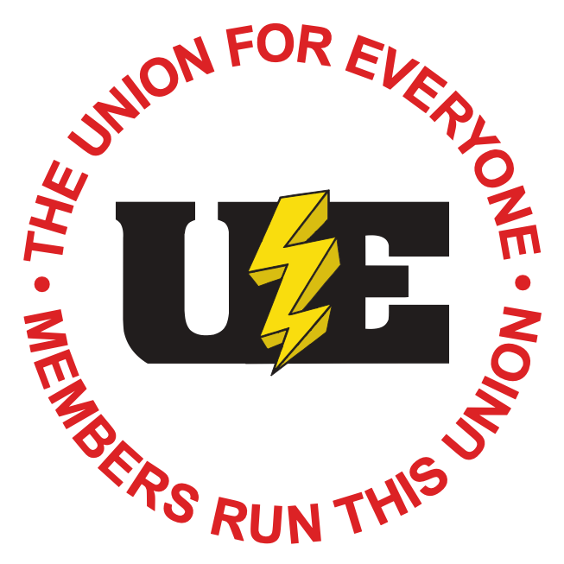

Notes:
A decision you'll need to make at some point is whether to associate with a parent union or remain independent. GetThru Workers United is part of CWA, the Communication Workers of America. That has worked for us, but other unions may work well for you as well. These are just a few out there.

Slide 27
Worker-to-Worker Organizing
Notes:
The model I'm going to describe for you today is worker-to-worker organizing, where the focus is on the union rank-and-file organizing and running their own union. The national union is not going to come in and run your unionization efforts.
It's fair to ask what they're going to do for you then. The best way to describe them to a tech crowd is as a specialized contractor. They're going to come in and provide guidance and expertise on running a unionization drive. If they're doing their job well, you should always be in charge and they are there to provide help as needed.
I think this expertise is valuable, but your mileage may vary. The Amazon Labor Union that won an NLRB election in Staten Island in 2022 was independent. They did a fantastic job. But they were also exhausted and out of momentum by the end of that drive. They didn't have the resources to continue the momentum to successfully organize other warehouses. Maybe with a parent union they would have been able to. Alternatively, maybe they don't succeed if they don't go it alone.
I would recommend reaching out to other unions and asking them directly what they like about their parent union. I came into our process late, so I don't have a strong opinion on how CWA was to work with in those early days.

Slide 28
Tell workers it's their union and then behave that way.
Don't do for workers what they can do.
SEIU Local 1199 Advice For Rookie Organizers
Notes:
In worker-to-worker organizing, workers themselves are organizing their union and running their campaign. There may be professional help from a parent union, but it is just that, help. They are not there to run anything or make decisions for you. They are there to provide information and resources as you need them. They are there to guide you through legal mine fields.
In the worker-to-worker model...

Slide 29
1) Workers have a decisive say on strategy,
and
2) Workers begin organizing before receiving guidance from a parent union
and/or
3) Workers train and guide other workers in organizing methods
We Are the Union by Eric Blanc 40
Notes:
1) Workers have a decisive say on strategy,
and
2) Workers begin organizing before receiving guidance from a parent union
and/or
3) Workers train and guide other workers in organizing methods
One key reason for this is that top down, staff intensive organizing has been a failure for 50+ years. It costs significantly more money to organize a union than it used to in this model and it hasn't gotten results. The increase in organizing cost is absurd. It cost $88/worker to unionize steel workers in the 1930's. It routinely costs over $3,000/worker today. (blanc-2025-we-are-the-union)

Slide 30
Under-resourced organizing departments normally produce stretched-thin staff organizers and weak training programs, which in turn leads to the pursuit of ineffective shortcuts and cookie-cutter methods.
Blanc 179
Notes:
The worker-to-worker model fights this by getting rid of most of the paid staff in favor of the workers themselves running their campaign. They don't know your workplace like you do. Why should they be in charge of YOUR union?
This also effectively fights against the plummeting distrust in institutions that has occurred over the past 50 years. If workers are inclined to distrust the 3rd party coming in to run their campaign, why put them in charge at all? Better to take advantage of the bonds of trust you already have and can continue to build with your co-workers.

Slide 31
There has been a shift in how people are organizing together to petition for representation. What was once a top-down approach, whereby the union would seek out a group of individuals, has flipped entirely. Now, individuals are banding together to form grassroots organizing movements where individual employees are the ones to invite the labor organization to assist them in their pursuit to be represented.
Michael J. Lotito et al., WPI Labor Day Report (Littler Workplace Policy Institute, 2022), 27.
Notes:
Littler Mendelson is a union busting firm. They've taken notice of this change in tactics in recent years.
In tech, we're used to this kind of independence this model gives. This model works for us. Have you ever seen the reaction of a team when an unwanted outside contractor shows up? I've been on consulting teams that were brought in by management against the wishes of employees. It's not good.
But, in many ways, we're used to planning our own work. Give us a goal and let us figure it out. Our profession selects for people with this personality type in many ways. Let's harness that.

Slide 32
The thing is, no one knows how to do this before they do it. I keep saying that to people. I'm like, "No one comes into this qualified." Most people have never organized a union.
Nora Keller - Labor organizer, former product manager at the NYT
Marcotte 70
Notes:
Let's get into the nuts and bolts. You're not happy with various parts of your job and you think a union could make it better. The idea of worker-to-worker organizing appeals to you. How do you get started?
No one knows what they are doing when they start. It's fine. A lot of you in this room feel the same way about your day job. Nobody just shows up and knows how to write software. Nobody shows up and intimately knows a new domain. This is a new domain.

Slide 33
[Quiet conversations are] quite literally the starting point for your union campaign. Quiet conversations with friends and allies, imagining a version of your work that's fairer, more equitable, and better.
Marcotte 75
Notes:
First, you need to start having quiet conversations with your co-workers. These conversations should be as high resolution as possible. In person is best. Video calls are second. Phone calls next, and then text. You're building relationships and humans build relationships best in person. This is, ultimately, a human endeavor. There is a place for digital tools, but you can't automate the humanity out of this.
You probably have a good idea of who you can talk to about this. Who would be receptive to the idea at all? Who should you absolutely not talk to first because they will immediately talk to management about it? It's illegal to fire an employee for discussing unionization, but many employers will make up some other reason to do so. This is called pretext. And with the NLRB currently being toothless thanks to the current administration, good luck getting the law enforced.
You want to reach out to wide range of co-workers. Eventually you want to talk to...

Slide 34
Every Single One
Notes:
EVERY. SINGLE. ONE of them. What do they like about their job? What don't they like about it? What commonalities do you have? What suggestions do they have for fixing things they don't like? You need to build relationships and overcome differences with them. This is a trust building exercise. And the best way to build trust is by being trustworthy and listening.

Slide 35
An axiom of organizers is that every good organizing conversation makes everyone at least a little uncomfortable
No Shortcuts: Organizing for Power in the New Guilded Age by Jane McAlevey 37
Notes:
There is no room for ideological purity here either. I don't care what political disagreements you have with various co-workers. If they're on board with helping form a union, you can work with that. The union represents all employees in the bargaining unit. No matter how much they insist that Bernie really won in 2016, you can work with them on this.
As part of these conversations, you should be tracking in detail who is on board? Who is a hard no? Who is on the fence? When did you last talk to them? There are spreadsheets to help with this. Resist the urge to start writing your own tools. There are many apps that could have just been a spreadsheet. This is one of those cases. There are communities out there already with resources you can use.
And all of that will be helpful when it's time start forming the organizing committee.

Slide 36
Mobilizing is essentially doing a very good job at getting people off the couch who largely already agree with you. [...] Organizing, which I put the highest value on , is the process by which people change their opinions and change their views. Organizing is what I call "base expansion," meaning it's expanding either the political or the societal basis from which you can then later mobilize. What makes organizing different than all other kinds of activism is it puts you in direct contact every day with people who have no shared political values whatsoever.
Jane McAlevey
Klein, Ezra, host. "A master class in organizing with Jane McAlevey", Ezra Klein Show, 16 Mar. 2020 https://www.vox.com/podcasts/2020/3/17/21182149/jane-mcalevey-the-ezra-klein-show-labor-organizing
Notes:
The organizing committee is the core group who is going to lead this effort. In the worker-to-worker model, we want as many people involved as possible. You're shooting for 10% of the bargaining unit being part of the committee.
It is the "organizing" committee. That is where the emphasis is. You're not mobilizing people who already agree with you. A lot of those people are probably already on the committee. You need to get everybody else on board. As many as possible, as high as 90% support in the bargaining unit.

Slide 37
Persuasion is a skill sorely lacking today among US progressives, who often struggle to engage with people who don't share the totality of their view and who generally spend more time discussing with (or criticizing) each other than they do reaching out to the unconvinced.
Blanc 24
Notes:
Your language should be flexible through this as well. It's easy for organizing committees to fall too hard into very left coded language that will make others feel excluded. The tone of your organizing committee needs to match that of your co-workers. Read the room. Talk to your audience in a way that will persuade them. You're not trying to persuade yourself.
Some people care only about wages. Others care deeply about respect and dignity at work. Respect your audience, be truthful, and listen to them.
As many people as possible should be in the bargaining unit. Not just software engineers. Not just QA. Not just the technical writers. As many as possible. You want a big tent. You don't want to create class divides among employees. What if the company tries to expand your bargaining unit later and previously excluding them created resentment? Management will exploit that. And you shouldn't be sowing division in your workplace anyways. We're hear to bring workers together.
Once again, your organizing committee needs to talk to every co-worker

Slide 38
Every Single One
Notes:
EVERY. SINGLE. ONE.
This is hard, but necessary. You need as much support as possible so you can handle some amount of attrition when your employer fights back. I will give one caveat though.
There will be people are very obviously firmly anti-union. If you suspect they are also the kind of person who will leak information to management, you probably need to exclude them for now. This is hard, but it's important to have as many of these conversations as possible before management finds out. You want to set the terms of debate. Management finding out too soon gives them the opportunity to start spreading fear, uncertainty, and doubt.
But, wait? Who actually is in the bargaining unit? That's... complicated.

Slide 39
Bargaining Unit
Notes:
But, wait? Who actually is in the bargaining unit? That's... complicated.

Slide 40
It Depends
Notes:
It depends on a number of factors. There are three broad categories.

Slide 41
Bargaining Unit Exclusions
Confidential employees
Managers
Workers who do not meet the criteria or classification that define the bargaining unit
Notes:
Confidential employees include anybody who has job duties involving access to the company's labor relations and bargaining strategies. This will be upper level management, legal, etc.
Managers are weird in tech. Strictly speaking, the law says that a manager is anybody who has the authority to hire and fire, offer promotions and bonuses, transfer or schedule other employees, and influence the company's policies. You might be a manager sitting in this room who isn't sure if you could be part of a bargaining unit or not after hearing that. We have lots of people in tech with "manager" in their title that don't do any of those things. Except for the very vague...

Slide 42
Influence the Company's Policies
Notes:
"influence the company's policies"
What does that even mean? That's incredibly vague in tech. How many layers of management down can say they influence company policy? Kickstarter United tried to get low level line managers into their bargaining unit and lost that fight. Kickstarter leadership was going to fight against it tooth and nail. They started using it as a wedge issue to spread fear, uncertainty, and doubt, so the union backed away from it.

Slide 43
Bargaining units are groups of workers who share clear "community interests" and constitute a distinct, recognizable, and homogeneous group of workers to be represented by a particular union. Bargaining unit members must be easily identifiable based on their job classification, department, location, skill, or other factor.
Unite & Win: The Workplace Organizer's Handbook 17
Notes:
The last one, "workers who do not meet the criteria or classification that define the bargaining unit", is where we start to feel circular. What this means is that you're going to negotiate for who is in the bargaining unit. The first two categories are not allowed in at all. Everything else is up for negotiation. Want a union of just QA testers? That's your bargaining unit. Want to include software engineers? Sure.
The union wants the largest possible bargaining unit that will vote yes. The company just wants a bargaining unit that will vote no. Sometimes this means pulling in departments that are anti-union. Sometimes this means trying to exclude departments that are pro-union. They'll use this as yet another wedge issue to pit co-workers against each other. They want to foment class warfare between potential members of the bargaining unit to stop this endeavor ASAP.

Slide 44
Leader Identification
Notes:
Let's assume the organizing committee has a goal of who should be in the bargaining unit. But how do we get those people on board? In each department and team, who is influential?
We all know that company's have both official and unofficial org charts. It doesn't matter who the org chart says leads a team or department. The employees on the ground know who to trust. They know who they are willing to listen to. They know who the unofficial leaders are. Those are the people to identify.
Those are the people you need to quickly turn an entire team that may have been uncertain or even outright hostile into supporters. Those are the people you can turn to execute tasks, come to meetings, or participate in actions. They will be able to have one-on-one conversations with co-workers you may never have met. Or who won't listen to you no matter what. They may not listen to you, but they'll listen to Matt. They'll listen to Heather. They'll listen to Arvind.
You will want to track these conversations. You want to know who you can rely on. Who is a hard yes? A hard no? Who is on the fence? Rate the level of support on some scale like 1-5. Track when you last talked to this person and who talked to them.

Slide 45
What do they want to preserve?
What did you talk to them about?
What do they like about their job?
What would they like to change?
What are they worried about losing?
What concerns did they bring up?
What do they dislike?
Notes:
And also track more subjective information. What did you talk to them about? What concerns did they bring up? What do they like about their job? What do they want to preserve? What are they worried about losing? What do they dislike? What would they like to change to help with that?
So many of these things are squishy, but you need to track them. If a certain issue keeps coming up in conversations, that is something to spend more resources on. Can you write up a request to management about it? They don't have to know that a unionization drive is happening yet. In fact, it's better if they don't know yet. You don't want them to know until the last possible moment. But you can bring up issues to management simply as concerned employees.

Slide 46
Structure Tests
Notes:
At various points during this process, you are going to undergo what are commonly known as "structure tests". These are designed to test the resolve of your coworkers that you've been charting and show a level of seriousness to management. Your co-workers say they're committed to this endeavor, but you need to put that to the test in a series of escalating actions.
There are no shortcuts here. You have to do the work and then structure tests validate that work. In software engineering terms, these are project milestones. Ideally, project milestones are regular checkins on progress and opportunities to validate the health of a project overall. Structure tests are similar. They show your co-workers that you're together and they show the company that you're serious. They validate your progress and the reaction of your employer lets you know if you need to pivot your plans or not.
These structure tests are not one-off actions. They are coordinated and executed with intent. The reaction of both the co-workers your organizing and management will tell you a lot.

Slide 47
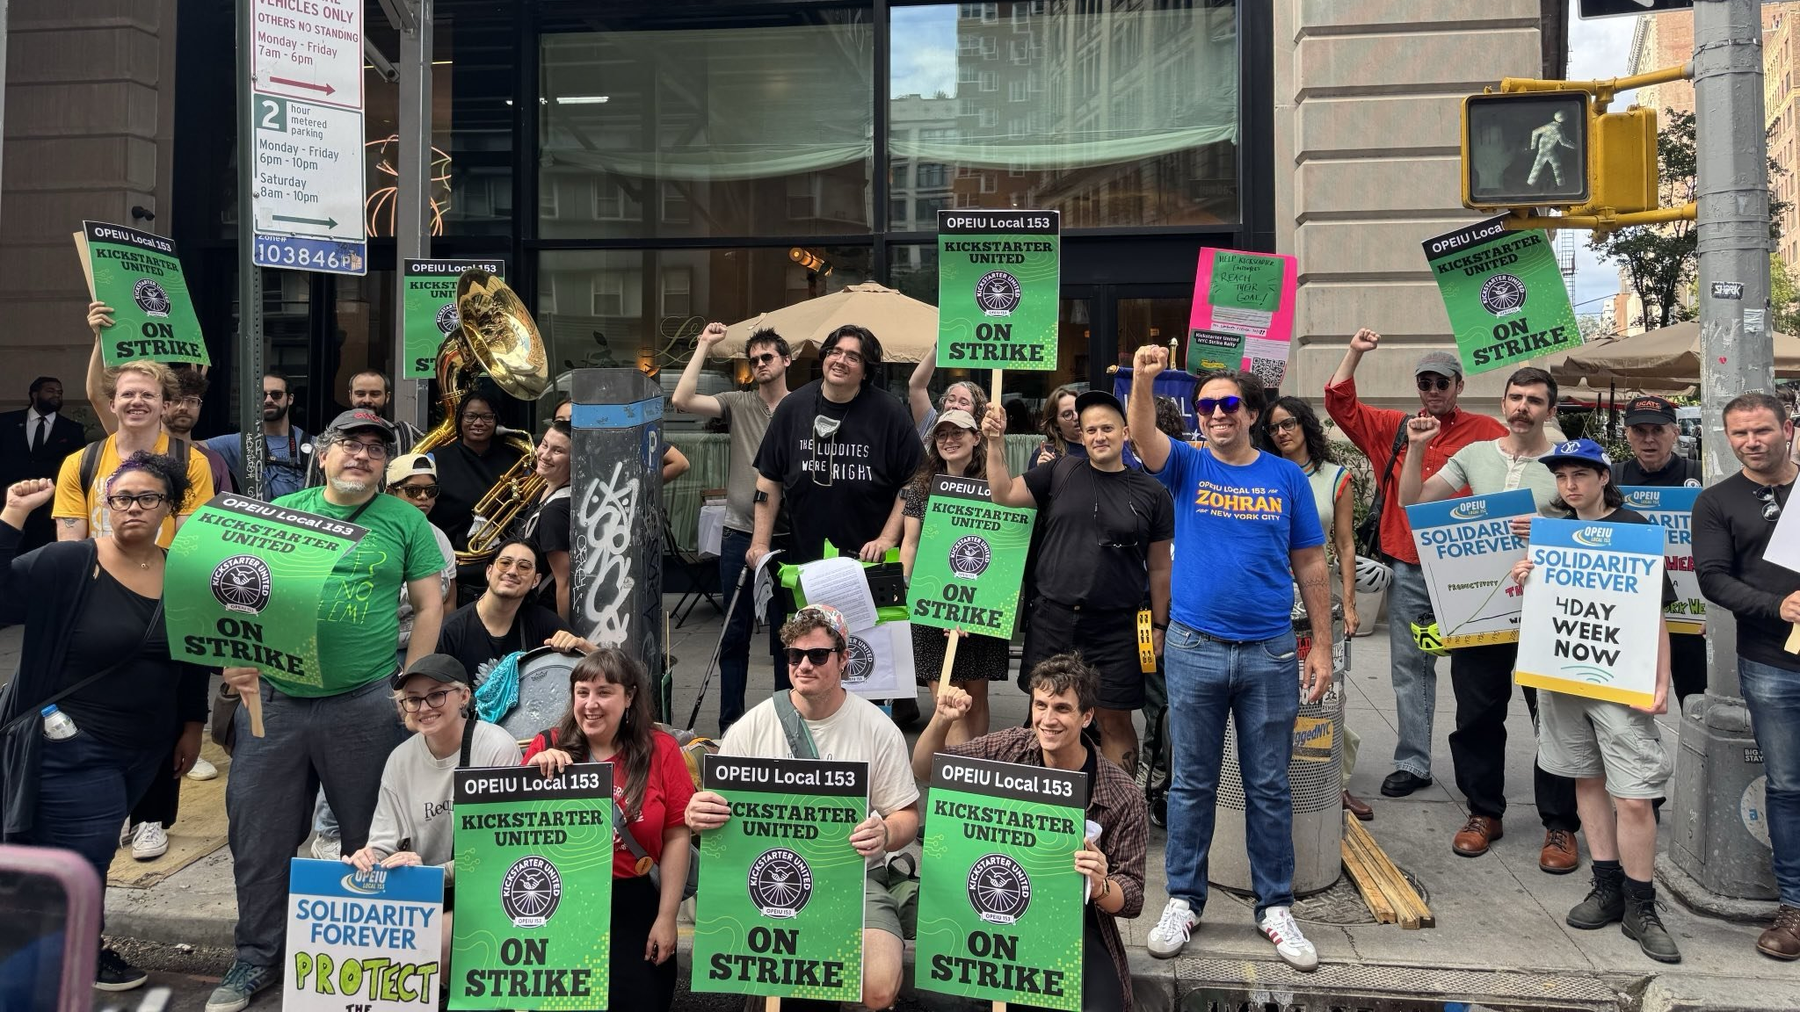
https://www.opeiulocal153.org/news/kickstarter-united-nyc-opeiu-153-elected-officials-amp-labor-leaders-hold-strike-rally-and-picket
Notes:
Structure tests are designed to escalate, all the way up to a strike if necessary. You want to continue unifying your co-workers and continue to show the company that you're serious.
These can start very simply. For example, you're a remote company and everybody changes their backgrounds to the union logo. Or you deliver a signed petition to management protesting some action or suggesting some change. The goal is to put visible pressure on management. It requires those who have shown support privately to shift that support to a public forum.
Your goal is a supermajority of support. You want 80%, 90%. It's easier for management to drive a wedge into your unionization drive if you only have 50% support. It's a lot harder to do that when you have a supermajority of support.
Structure tests are a tool you use along the way to test that level of support. It's real easy for someone to click a like button on social media. Structure tests ask them to show an escalating level of commitment. And that is necessary because, before your unionization vote, the union busting campaign is coming.

Slide 48
When I'm talking to new stores, I usually have to spend a lot of time convincing folks not to look for shortcuts. We're not the people to be reinventing the wheel, right? We have to focus on doing what works, and then maybe down the road we can make changes that are actually informed by experience -- but outside of that, we're not making improvements, we're just doing random shit. So it's really important that people do things by the book; there's a reason why people do it that way.
Jamie Edwards - from independent union Trader Joe's United
Blanc 176
Notes:
You'll be tempted to move forward before having a supermajority. You should resist that urge as long as possible.
But just like in tech, be risky when necessary. Best practices are not always the practices that you should follow in your situation. But you need to be able to clearly articulate why you're deviating from the best practices. Smart organizations know when to bend the rules because they know why the rules existed in the first place. Be smart.

Slide 49
Union Busting
Notes:
I've been hinting at this as we go, but let's get explicit. Management is probably going to retaliate when they learn about the unionization effort. Fortunately, I don't have direct experience with this. We were lucky at GetThru. The company voluntarily recognized the union.
Now, that didn't mean that contract negotiations were smooth sailing. It took almost three years to go from voluntary recognition to a ratified contract. But it was nice that they didn't bring in a union busting law firm. You will probably not be so lucky.
To be blunt, you should assume your employer will break the law. If they're anti-union, getting caught breaking labor laws is baked into the cost of the fight for them. And given how toothless the NLRB is, there is a good chance they'll get away with it.
There are a large number of common anti-union activities to watch for. There are a large number of law firms that specialize in this work and they all work from a similar playbook.

Slide 50
Inoculation
Captive audience meetings
One-on-ones
Weaponizing feelings and relationships
Concessions and favors
Retaliation against employees, especially lead organizers
Sowing fear and division
https://workerorganizing.org/anatomy-of-a-union-busting-campaign-8748/
Notes:
Since they all work from a similar playbook, you can prepare for this in advance. This is called inoculation. You want to expose as many of members of your bargaining unit to these techniques in advance of your union drive going public. You need to inoculate them against the plague your employer will release at the guidance of these firms. They will weaponize anti-union employees against you. They will give them talking points and promise them promotions. You need to be prepared.
Your employer will slow play all of these techniques. They are paying an expensive law firm to do this work for them in large part. Meanwhile, your organizing committee is effectively working two jobs. Members still have their day job with an employer who is now actively gaslighting them (and that is the correct usage of gaslighting) while also working evenings to organize a union. They want to drag this out in a strategy commonly known as "futility".
They want to wear you down. They want to test your resolve on a daily basis.

Slide 51
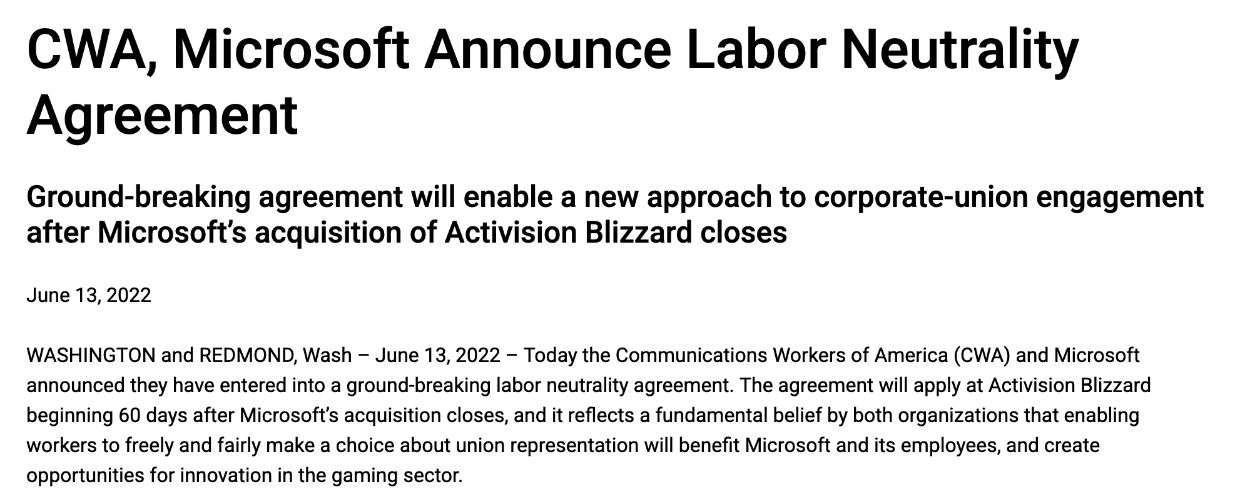
https://cwa-union.org/news/releases/cwa-microsoft-announce-labor-neutrality-agreement
Notes:
One hint to how successful these union busting techniques are is by looking at the gaming industry. Why has unionization flourished there? Beyond the industry culture of crunch and exploitation, one hint is that almost all of these gaming companies are now owned by Microsoft.
As a condition for approving the Activision Blizzard deal, Microsoft agreed not to union bust these gaming companies. They agreed to voluntarily recognize unions that showed a majority of their employees had signed a union card.
That's it. And that is why companies will spend a lot of money union busting. It works. When you don't have a 3rd party coming in to hold captive audience meeting and straight up lie to employees, unionization drives do a lot better. Imagine that.

Slide 52
Always remember: your bosses can lie to you. You have legal protections under the NLRA to form a union. But there is absolutely nothing that legally requires your management to tell you the truth.
Marcotte 100
Notes:
And I do want to emphasize the straight up lying part. Management can say whatever they want. There is nothing illegal about your company gaslighting you in a captive audience meeting. Nothing at all. Management can get you in a 1-on-1 make up whatever they want. That's the law. The deck is stacked against unions.
I'm going to leave it here for now, but it is a big deal. No matter how much you think your employer will support you. No matter how much you think their values align with your own, you should assume they will engage in some level of union busting tactics. Plan for the worst and hope for the best.
And no matter what, act like a union that is going to win throughout the process. They want you to feel futility. Make them feel like you are inevitable.

Slide 53
Organizing Remotely
Notes:
Organizing remotely is it's own challenge. How many people in this room work remotely? How many of you have consciously adjusted your communication patterns to work effectively remotely? How many of you wish you worked on a team like that?
A lot of the same rules for effective remote teams apply here. You're not going to get serendipitous moments of communication. There will be no hallway chat where you can ask your co-worker how they are doing and if they want to get some coffee to chat later. There won't be a communal gathering spot.
There also won't be a risk of your employer overhearing your private Zoom call. There are pros and cons here.

Slide 54
Get Off Company Channels
Notes:
One huge rule though is to get off company communication channels as quickly as possible. You should assume that your boss can read everything in Slack. Depending on your industry, your company may be paying for an expensive Teams plan that preserves absolutely everything and gives management the ability to search all messages. They may be legally required to have this. And that means you should assume they will read your messages, so get off the company Slack ASAP.
And don't open any of these resources on your work computer. Don't open your organizing chart. Don't open your union Discord. Always assume your employer can see what is on your machine at any time. Remember, you want to avoid going public as long as possible. Eventually there will be a leak, but you want to hold that off.
Rockstar Games in the UK just fired 31 workers this fall, claiming they had shared confidential information outside the company. They won't say what it was of course, but the current suspicion is that they were discussing changes to company policies in the union organizing Discord. A leak of GTA VI this was not.
Communicate with co-workers on their terms. I said earlier that there is a hierarchy of effective communication, with in-person at one end and texts at another. They all have their purpose though and you need to meet your co-workers where they are. They may not feel comfortable talking about unionization in person. They may want to text about it some to get comfortable and let themselves think between messages.

Slide 55
Issues to Organize Around
Notes:
You can use whatever issues you want to get employees on board with unionization. That doesn't mean the company has to negotiate over it when you get to collective bargaining, but that's fine. Stick your flag in the ground for what you and your co-workers care about and believe in.

Slide 56
Tech Examples
AI usage
Work hours
Who you do business with
On-call rotations and compensation
Contractor policy
Severance packages and recall rights
Hiring juniors
Notes:
Our industry is different than most others people associate with unions. Many of us get paid very well. Wages are not necessarily at the top of the priority list when negotiating a contract. That's different than many other industries. That doesn't mean unions can't benefit us though.
NewGuild has restrictions in their contracts on what can and can't be done with AI in the newsroom. That seems pretty relevant these days. Kickstarter United doesn't have a strong restriction on AI in their new contract, but does have language around requiring training and justification from management when new tools are introduced.
Kickstarter United has a four day work week. They went on strike over it in 2025. And if you read their contract, it's very easy to see it was by far the most contentious issue in the contract. It's a complicated article laying out exactly what will happen if Kickstarter tries to take away the four day work week. Usually, you can't strike when a contract is active. Kickstarter United has explicit language that allow them to strike if Kickstarter goes back to a five day work week and certain mediations don't resolve the issue.
Or maybe you want to explicitly encode working hours so you can delete Slack from your phone without any ambiguity.
You might want to negotiate over who the company does business with. This is very hard as it falls into the permissive category, but you can certainly use it as leverage in negotiations. Any permissive subject that management does not want to discuss can always be brought back later if you gain more leverage through various structure tests.
You could negotiate over on-call rotations and compensation. You could negotiate over when you are expected to respond to messages. You could negotiate a remote guarantee.
Maybe your employer really likes to work around the union with contractors. Propose an article outlining exactly what contractors can be used for and for how long.
What about recall rights after layoffs? Severance packages? Or maybe the status quo at your company is fantastic? Then lock it in with a contract. As we've seen over the past few years, you may really like your job and the perks that come with it. None of those are guaranteed though. They can be taken away at any time at the employer's discretion. A contract can lock them in.
We all know that junior engineers are in big trouble with the current AI trends. Your contract could look out for them. There needs to be an onramp into the industry still. Even if you think AI tooling is great, you still need to build expertise without it to use it well.

Slide 57
... scholars assume that material gain in the primary concern of unions, missing that workplace fights are most importantly about one of the deepest human emotional needs: dignity
McAlevey, No Shortcuts 1
Notes:
It does not have to be about material gain.
I'm a fan of SMART goals and those feel like a good fit here. Be precise in the issues you want to organize around. Give people something concrete to latch onto. "More money" is wishy washy. What is a success there? How will your co-workers feel about the goal? How will they know you've succeeded in getting them something?
When figuring out these issues, a big tent is necessary. The conversations with co-workers should be driving these. It's not what you want. It's what the bargaining unit wants. The asks won't be the same around the company either. Different departments have different needs.

Slide 58
NLRB Elections
Notes:
Let's briefly touch on NLRB elections.
First, if you're lucky enough that your employer voluntarily recognized the union when you presented them with signed union cards from over 50% of the bargaining unit, congratulations! You don't have to go through the NLRB election process!
That is the exception though. As I've stated before, your employer is almost certainly going to fight this and that means an NLRB election. This is a very formal secret ballot election for the entire bargaining unit. This unit will be explicitly defined now. There will no ambiguity about who can and can't vote.
One caveat to that is that if any employees have been fired and have filed an unfair labor practice charge with the NLRB against the company, they are eligible to cast a provisional ballot. Your employer may throw a fit over this, but it's legal.

Slide 59
30% Minimum
80%+ Ideal
Notes:
You will need at least 30% of employees in the bargaining unit to have signed a card, but you never want to file for an election with such a low number. You want a supermajority. Ideally, you have 80-90% support to give you a buffer. Victory requires 50% + 1 of all eligible votes cast. Having a supermajority gives you confidence that the election is a formality.
If your employer is engaged in union busting, it is to there advantage to postpone the election as long as possible. This is because union cards are only good for one year. If they can drag out the process long enough, they can force you to collect signatures on cards again.
For remote companies, the NLRB does have a process for mail-in voting, but I don't know any details about how it works.

Slide 60
The collective bargaining table is the only place under US law where workers sit as legal equals to their employer
McAlevey, No Shortcuts 57
Notes:
So, you've had your NLRB election and you won! Congratulations! You're halfway there! Now it's time to negotiate a contract, your collective bargaining agreement.
We don't have time to go deep into collective bargaining. Once again, if you're starting today, you're at least a year away from this, probably more, so don't worry about it right now.

Slide 61
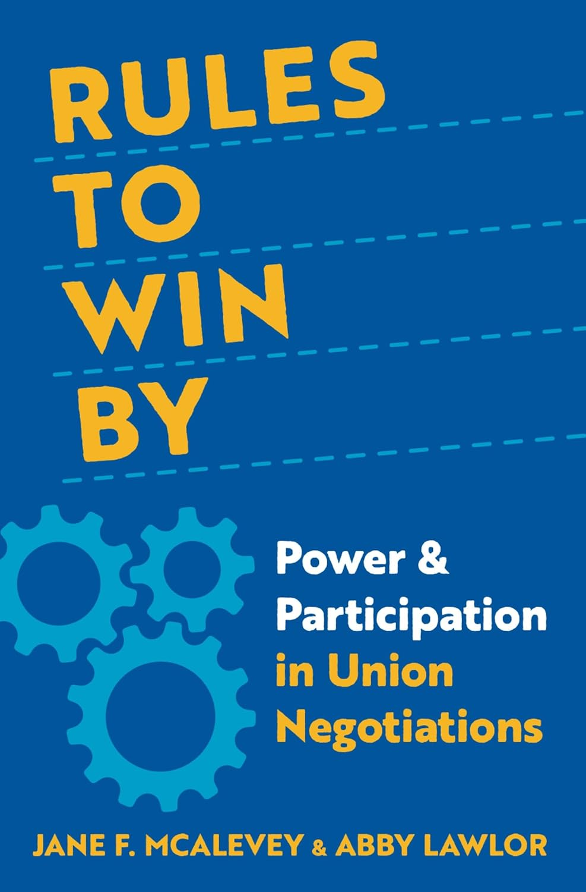
Notes:
I highly, highly recommend reading Rules To Win By when you're getting close to this point though. It's all about the do's and don'ts of union negotiations in the worker-to-worker model. I'm a big fan of the ideas around high-participation negotiations. They break it down to these key elements

Slide 62
High Participation Negotiations
Conducting a power structure analysis
The information request
Majority contract survey as organizing/reorganizing tool
A big, representative committee
Electing committees (not appointing)
A volunteer, not paid committee
Ratify contract proposals before negotiations
Creating article committees
Three rules of the room when management is present
No ground rules (if state law requires, surrender-on-power-ones)
Location, where to negotiate
When and how often to conduct negotiations sessions
Avoid employer and lawyer communication between sessions
Training, role-playing, and the opening session
The article checklist: make it easy for workers to follow
The role of the union caucus
Negotiations bulletins, simple and published before the employers'
Comprehensive charting and the community campaign
Contract action teams
Ratification of the contract
McAlevey and Lawlor 33
Notes:
It goes over information you can and should request from the company before negotiations begin, such as pay information for everybody in the bargaining unit. You know how companies like to say they don't have any pay discrimination. You get to check their work. They're legally required to give you this information.
You can negotiate over the very terms of negotiation. Management will probably say that isn't true because there is a pretty standard template that has formed over the years, mostly to the benefit of management. You don't have to agree with that.
For example, they'll probably want restrictions on the size of the bargaining committee. You don't have to agree to that. You don't have to agree to any media blackouts or gag orders. You don't have to agree to just about anything they come back with. If you want negotiations to be public to entire bargaining unit to every session, you can do that. They cannot tell you no in the US.
You want rules that keep the bargaining unit engaged because you still might have to strike. A strike is the culmination of all the structure tests leading up to that point. During negotiations you may have various structure tests that show how united you still are. Your employer still wants to engage in futility here. You won the election, but they want to burn you out before a contract. They want you to question if this is still worth it. They're probably still paying their expensive union busting law firm and they expect to get results out of it.
As to the contract itself, negotiations will be separated into two buckets, mandatory and permissive articles. These lines can be very fuzzy and subject to intense litigation. Mandatory articles include just about everything with respect to "wages, hours, and other terms and conditions of employment."
This is very vague and complicated though. Borg-Warner is the Supreme Court case to read up on if you're curious. We won't go into it now, but this is a deep topic that you'll want to talk to your parent union about in detail here. There is a lot of legal precedent that will restrict what you can and can't force the company negotiate over. Importantly though, you can always propose the article. Just don't be surprised if your employer pushes back with the idea that it's a permissive and they don't have to negotiate on it.

Slide 63
But for a labor negotiator, its advice presumes a particular reality: the employer is not only willing to settle but is willing to allow the other party to continue to exist.
McAlevey and Lawlor 15
Notes:
If you're familiar with books on negotiation like "Getting to Yes" by Roger Fisher and William Ury, they aren't worthless here, but a fundamental assumption they make is not true here. Management likely does not believe that your union even has a right to exist. Keep that in mind.

Slide 64
Guiding Lights
Notes:
You will have a couple of guiding lights during negotiations.
First, will be the issues you're bargaining unit cares about. You should already know these going into negotiations because of all the conversations you've had with every single member of your bargaining unit. Every. Single. One.
Even the vehemently anti-union ones now. They're part of the bargaining unit too.
You should be having internal elections for a bargaining committee. Every department represented by the bargaining unit should be at the table.
Even while your employer is dragging their feet to contest your NLRB election and postpone negotiations, you should be continuing these conversations and assigning contract articles to various committees in your bargaining unit.
Once again, it's your union, your contract. That means your union needs to be writing as much of the contract as possible. And, yes, you can and should run it past a lawyer at some point. But it's yours. They work for you, not the other way around.
Trust in institutions fails when people feel alienated from the institution, that it doesn't represent them at all. Keeping everybody involved to the extent that they want to be involved fights this.

Slide 65
Power Structure Analysis
Notes:
The other guiding light is a power structure analysis. Jane McAlevey and Abby Lawlor recommend a three-phase approach.

Slide 66
Who holds the power in the labor market, and where does the employer's quantifiable power fit into the picture?
McAlevey and Lawlor 208
Notes:
First, What relationships does your employer have in the market? What levers can be used against them? This is going to involve talking to a lot of people outside the company. If your company has a board, what other boards do they sit on? What media covers your employer and your market? Are there influential non-profits or customers are dependent on your employer in some way? Basically, what institutions and people have influence over the company?

Slide 67
How does the workers' power structure in workplace relationships operate, and who among the workers can strengthen the union to achieve a supermajority structure?
McAlevey and Lawlor 208
Notes:
Who in your workplace actually wields power and influence? This ties back into leader identification and workplace charting. Just like we care about who has influence over the company, who has influence over members of your bargaining unit? Who do they listen to within the workplace?

Slide 68
What points of pressure on that local power structure do the growing corps of high-trust worker leaders have, and how can they, as whole workers living full lives in the community, move actors who can push the boss toward meeting workers' demands?
McAlevey and Lawlor 208
Notes:
And then what relationships do members of the bargaining unit have outside the bargaining unit that can be leveraged? Do they have a connection to any of those levers you've identified in point 1?
This is much harder to do in a remote context, but not impossible. Maybe you've been able to get a bit of media coverage and have built a bit of a relationship with a reporter. That's a lever. Maybe you have influential connections from past jobs that you can leverage. It's harder, but not impossible.

Slide 69
This Will Be Hard
Notes:
If you choose to go down this path, it will not be easy. It will be hard. You should expect the process to take at least 2 years. You're employer will likely fight you every step of the way, often using illegal tactics that the NLRB is too toothless (by design) to stop. You should expect some organizers to be fired for spurious reasons. You might eventually get back pay out of the NLRB, but you shouldn't count on it.
But you will not get lasting change without it. As we've seen over the past few years, your employer can take away your benefits whenever they want. If you want some control over that, you need to collectively bargain to guarantee your rights.

Slide 70
... there's no instance in the United States of major progressive changes in the division of corporate profits that required anything less than mass strikes and collective action. The tech sector may be new, but its executives' desire to increase their own profit is anything but.
McAlevey, A Collective Bargain 135
Notes:
At it's core, this entire process is political, but as local as possible. Unfortunately, national politics do matter though. Trump fired members of the NLRB last January, preventing them from having quorum for 11 months. Last month, the Senate approved two new NLRB members and a new general counsel. They are expected to dismantle many pro-labor rules passed during the Biden administration. This is only going to get harder, but it can still be done.

Slide 71
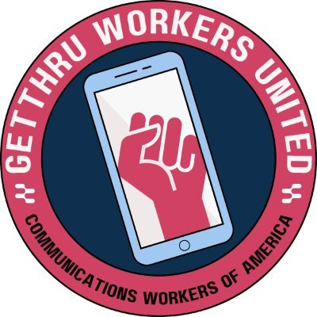
Notes:
Unions like Kickstarter United and GetThru Workers United have paved the way. There are resources out there on how to organize in the tech industry that didn't exist 5-10 years ago. It's not a novelty anymore. It can and should be done.
For the past 50 years the labor movement has been weakened. It's resorted to giving up on organizing new unions in favor of trying to change laws to make it easier to organize. This has been an abject failure. You have to build labor power to affect the political process. You can't wait for legislative changes to enable more labor power first. It hasn't worked for the past 50 years and it's not going to work anytime soon.
Many of you are probably familiar with large legacy unions. You probably have heard family members complain about them. Part of that is natural. No large organization is perfect.

Slide 72
It's YOUR Union
Notes:
However, the union you build is YOUR union. It will have problems. Any structure built by people and consisting of people will. That is inevitable. We've all seen the decline in existing institutions. The time is now for new institutions, institutions you can build yourself.
The power is in your hands. Take it.

Slide 73
Resources
CODE-CWA Organizer Training: https://code-cwa.org/upcoming-trainings
EWOC: https://workerorganizing.org/training/
Unite & Win Podcast: https://podcasts.apple.com/us/podcast/unite-and-win-a-guide-to-workplace-organizing/id1866713309
Kickstarter United Oral History Podcast: https://kickstarterunited.org/oral-history/
Notes:
CODE-CWA focuses on organizing in the tech industry. They just started a new training series this past Sunday, but they're running classes every Sundays for at least the next 7 weeks on some of the topics we touched on today.
The Emergency Workplace Organizing Committee offers many great resources. They run training on a regular basis. The next series starts on March 4th. They also started a podcast series of their Unite & Win handbook this week. If you are interested, I have five copies of it right here. This is an excellent primer on worker-to-worker organizing. You can breeze through it in an hour or less. Just come chat with me if you want one.
There are many other resources out there too. These are a great starting point.

Slide 74
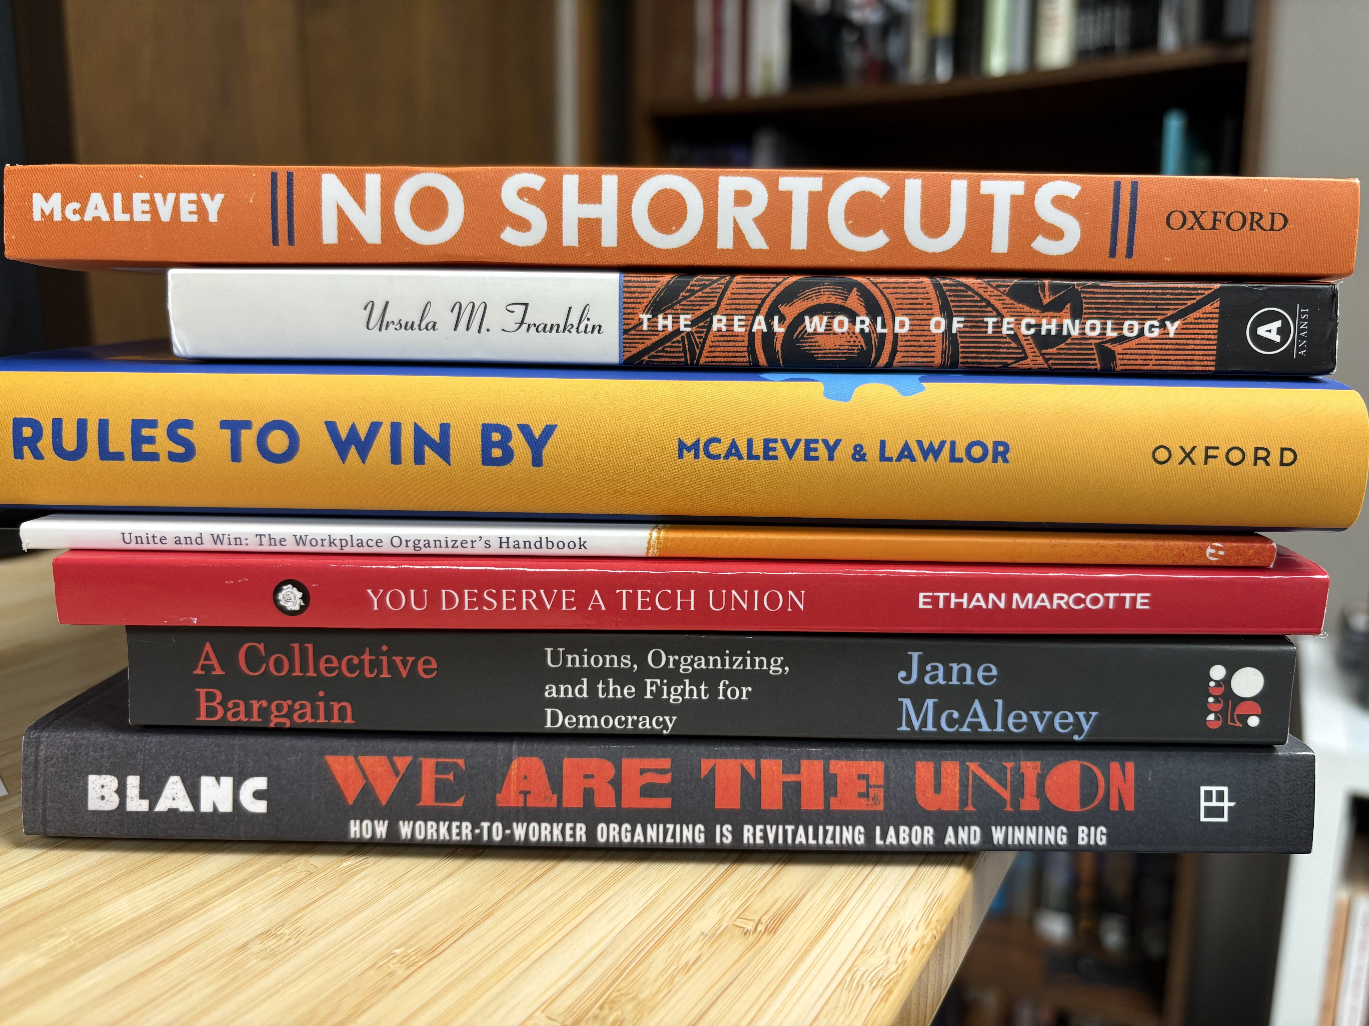
Citations
Blanc, Eric. We Are the Union: How Worker-to-Worker Organizing Is Revitalizing Labor and Winning Big. Univ of California Press, 2025.
Committee, Emergency Workplace Organizing. Unite and Win: The Workplace Organizer’s Handbook. Haymarket Books, 2024.
Franklin, Ursula. The Real World of Technology. House of Anansi, 1999.
Marcotte, Ethan. You Deserve a Tech Union. 2023.
Mcalevey, Jane. A Collective Bargain: Rebuilding Unions, Rebuilding Democracy. Ecco, 2020.
McAlevey, Jane. No Shortcuts: Organizing for Power in the New Gilded Age. Oxford UP, 2016.
McAlevey, Jane, and Abby Lawlor. Rules to Win By: Power and Participation in Union Negotiations. Oxford UP, 2023.
Redwine, Clarissa, host. Kickstarter United Oral History, 3 Nov. 2020 https://kickstarterunited.org/oral-history/
Notes:
I did a lot of reading and learning for this talk. These are also listed in the README for this talk on GitHub. Even if you aren't interested in labor organizing, I highly recommend The Real World of Technology by Ursula Franklin. It's a fantastic series of lectures from 1989 on the affects of technology on society. It remains highly relevant even today.

Slide 75
"Horizontal Team Building"
Notes:
You don't have to tell your boss that you came to this talk (remember, "horizontal team building"), but I hope it spurs conversations with your co-workers. Please find me throughout the rest of the conference if you want to chat or ask questions. I'm pretty easy to find. Just look for the frail guy with long hair and a blue arm.

Slide 76
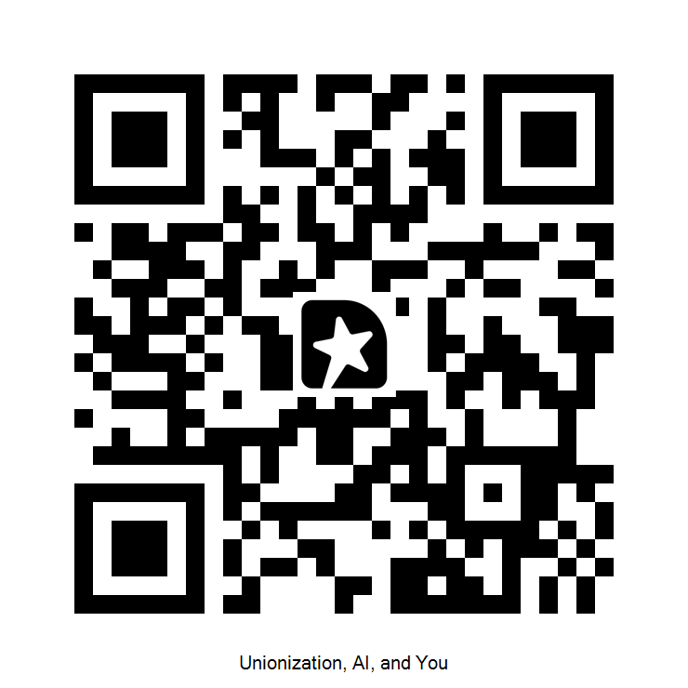
Feedback
Notes:
Feedback is appreciated, both good and bad. That QR code will take you directly to where you can leave feedback on this talk.
Big kudos to the selection committee for even accepting a talk like this and thanks to everybody here for coming to my talk today. This entire process stats with conversations. I wish you well in your journey.
(Maybe time for questions now. Find me later if we don't have time.)

